Slide 1
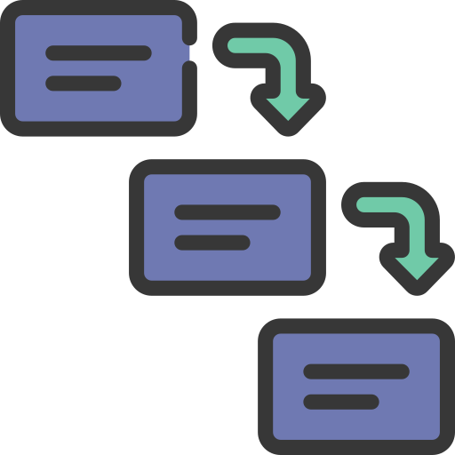

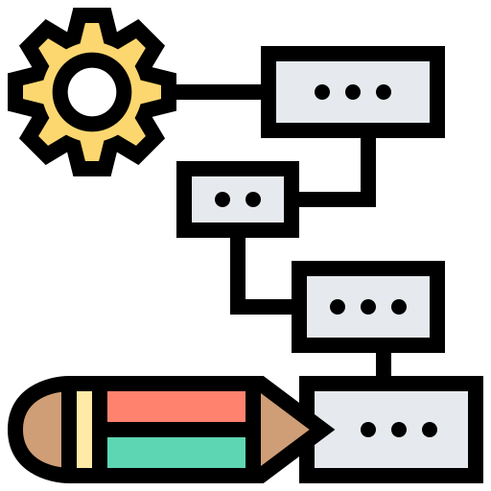
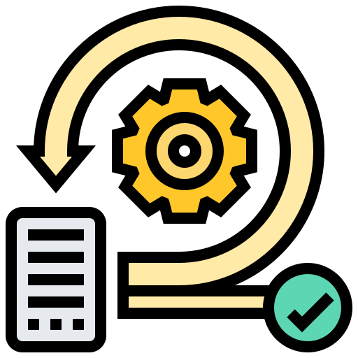
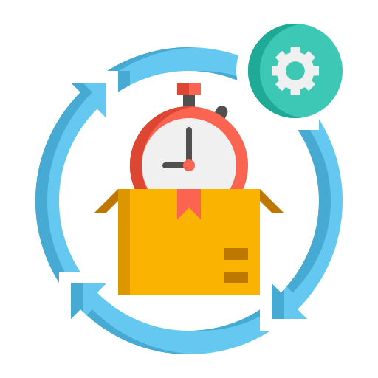
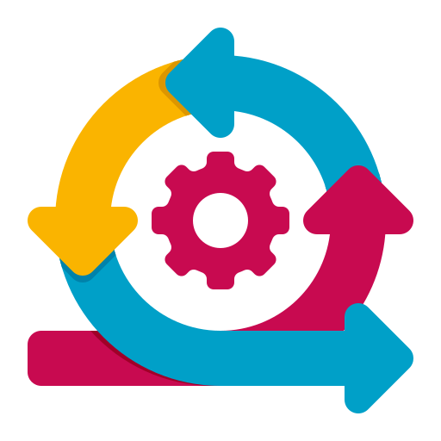
SDLC Models
Waterfall Model
Sprial Model
Prototype Model
Iterative Model
RAD Model
Agile Model

Slide 2


Waterfall Model (SDLC)
Pros
Waterfall Model: The earliest and most popular structured SDLC model.
Requirement Analysis
straightforward and simple to use
Each phase is processed and finished separately
Works effectively for small projects
System Design
The software development process is broken down into various sequential phases.
Implementation
Cons
System Testing
Each phase has its own set of activities and goals.
Not suitable for intricate and object-oriented projects
unable to adapt to changing requirements
Risk and uncertainty are very high.
System Deployment
One phase's output becomes the next phase's input.
System Maintenance

Slide 3
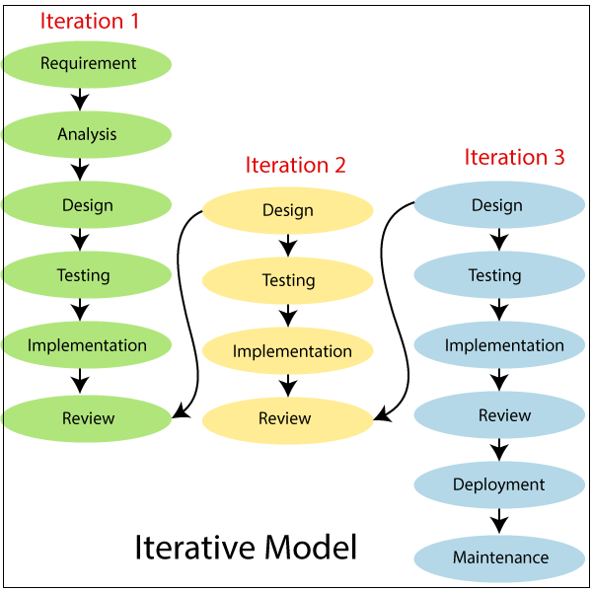
Iterative Model (SDLC)
Pros
Development begins with specific set of requirements that iteratively improves and develops the software.
Parallel development can be planned.
Results are obtained early and periodically
Less costly to change the scope/requirements.
The total software development is divided into iterations and each iteration has design, development and review.
Cons
After each iteration, this procedure is repeated to create a new version of the software.
Management complexity is more.
More resources may be required
Not suitable for smaller projects.
Difficult to add the change requests.
The planning and requirement analysis, deployment and maintenance are one time ,and doesn’t involve in iterations.

Slide 4
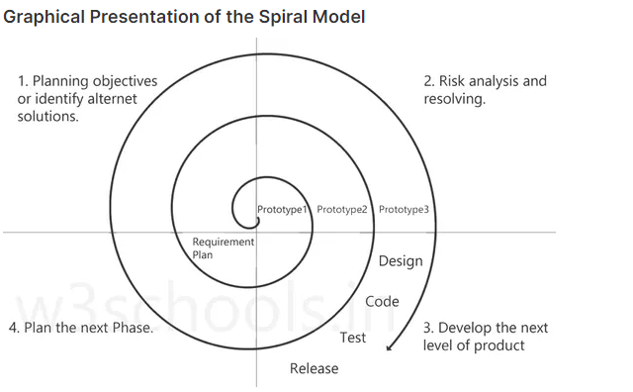
Spiral Model (SDLC)
Pros
Spiral Model: Couples the idea of iterative development with the systematic, controlled aspects of the waterfall model.
High amount of risk analysis
Useful for large and mission-critical projects.
The software is created through a series of incremental releases using the spiral methodology.
Cons
The additional release during the initial rounds could be a paper model or prototype.
Can be a costly model to use.
Risk analysis needed highly particular expertise
Doesn't work well for smaller projects.
Later iterations result in ever-more-complete versions of the engineered system.

Slide 5
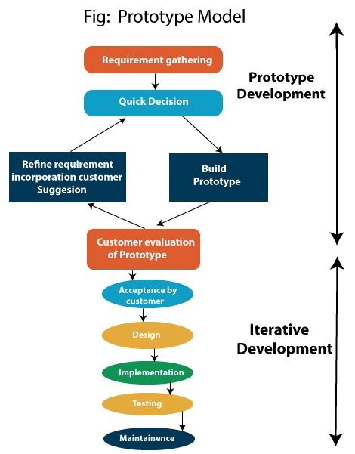
Prototype Model (SDLC)
Pros
A prototype is created, tested, and modified necessarily so that the full system or product can be developed.
Increased user involvement in the product even before its implementation.
Reduces time and cost
Missing functionality can be identified easily.
This model performs best in situations where not all of the project needs are known in detail beforehand.
Cons
A functioning system prototype must be created before the actual software is developed.
Users may get confused in the prototypes and actual systems.
Developers may try to reuse the existing prototypes to build the actual system
A system prototype is a toy version of the actual system.

Slide 6
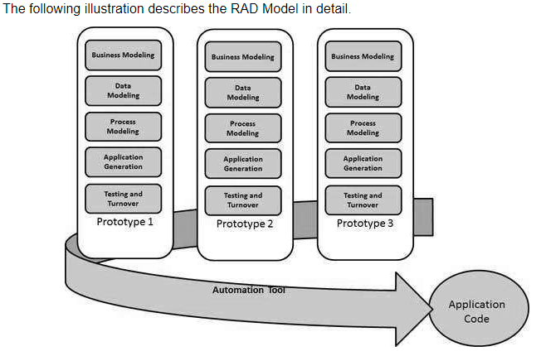
RAD (Rapid Application Development) Model (SDLC)
Pros
RAD model is based on prototyping and iterative development with no specific planning involved.
Progress can be measured.
It reduced development time.
It increases the reusability of features.
Functional modules are developed concurrently and then combined to create the finished product
Cons
It is simpler to accommodate modifications throughout the development.
Only system that can be modularized can be built
High dependency on Modeling skills.
Suitable for projects requiring shorter development times.
The main features of the RAD model are that it emphasizes the reuse of templates, tools, processes, and code.

Slide 7
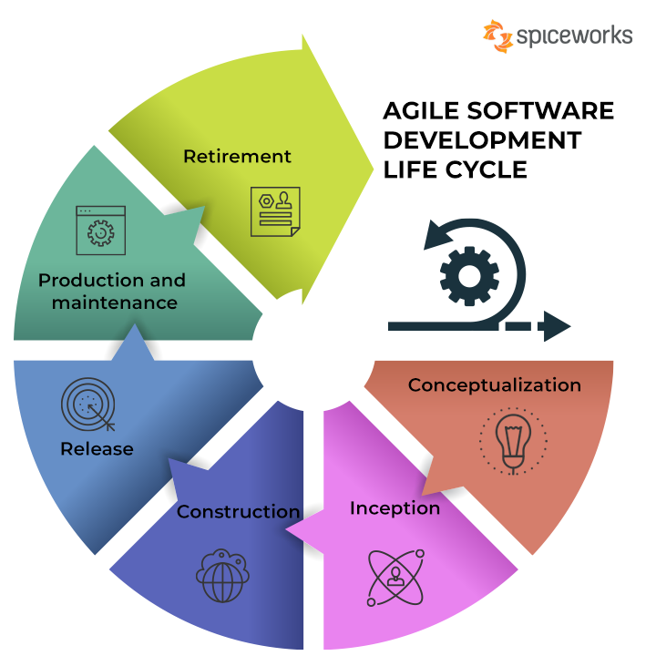
Agile Model (SDLC)
Pros
A method of software development based on iterative development.
Satisfied customers
Higher quality product
Easily and Quickly adapt to change
Predictable Delivery Dates
Agile methodologies minimize long-term planning by breaking down projects into smaller iterations or parts.
Cons
At the beginning of the development process, the project's requirements and scope are established.
Short term planning
Lack of necessary documentation
Less predictable
Projects easily fall off track
Each iteration's duration, length, and scope are all precisely predetermined in advance.

